Slide 1
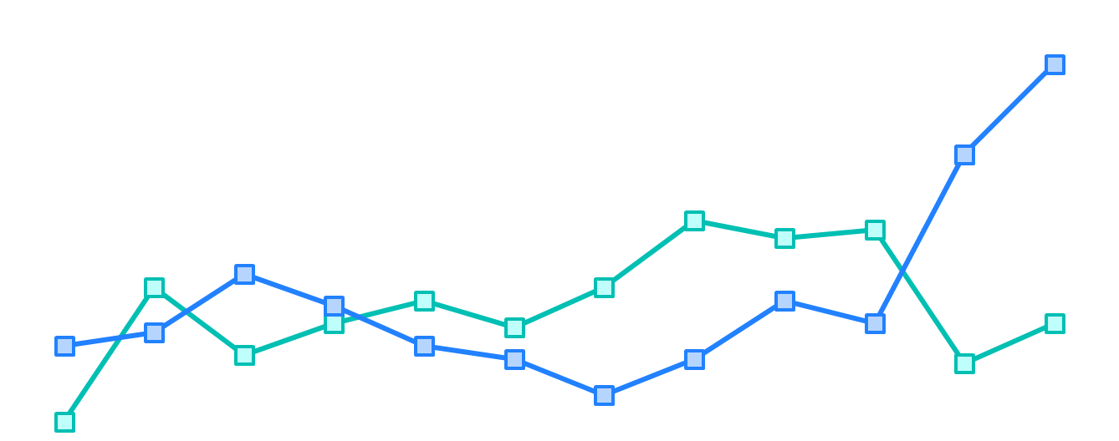
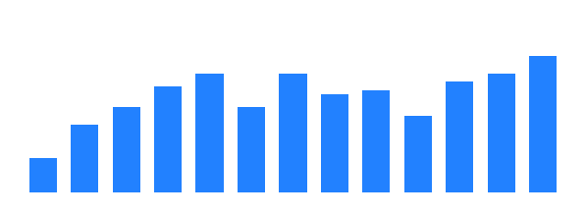
2021 TRB – Submit by Sep. 1! Innovations in Transit Performance Measurement Challenge
Entry Deadline Extended to Sept. 1
More details
Each year during Transportation Research Board’s Annual Meeting, the TRB Transit Management and Performance Standing Committee (AP010) and the Transformative Trends in Transit Data Committee hosts a Transit Performance Measurement Challenge.
Why do we host the Challenge? We believe decisions made with data results in better public transit that serves the needs of our communities! And we want to…
Introduce more people to the research and connections that TRB facilitates and provides
Contribute to the development of best practices in our industry
Build visibility of transit staff and agencies that are using fantastic data visualizations to tell stories that make changes
How can I or my organization participate?
Visit this site for the details on how to submit your entry by Sept. 1! Entries welcome in many categories such as operations, service planning or administration.
Please contact Alissa Zimmer (Azimmer@mbta.com) with any questions.
Sponsored by the Transit Management and Performance Committee (AP010) and the
Transformative Trends in Transit Data Committee

